Slide 2
House Prices factors across the united states

Slide 3
Introduction:
Real estate has always been considered as a fruitful asset in one’s investment portfolio, for the short term, as well as long term. But few factors which plays the major role in the prices of the house in any location.
Here below I have listed out the factor which makes the impact in the US house prices.
Interest Rates,
Inflation Rates,
Unemployment,
Population Growth,
Infrastructure Development

Slide 4
Interest Rates
Changes in interest rates also impact housing prices. When interest rates are low, home prices tend to be high. One reason is that low interest rates encourage buyers, and the more buyers there are, the more competition there is for available homes. Low interest rates also make purchasing a more expensive home possible. A lower interest rate lets you borrow more without seeing a huge jump in your monthly mortgage payment. When the interest rate goes up, however, so does your monthly mortgage payment. When interest rates rise, houses become less affordable unless their prices come down
As per latest sourcing details from FRED for DEC 15th 2022 the mortgage interest rate is 6.31%

Slide 5
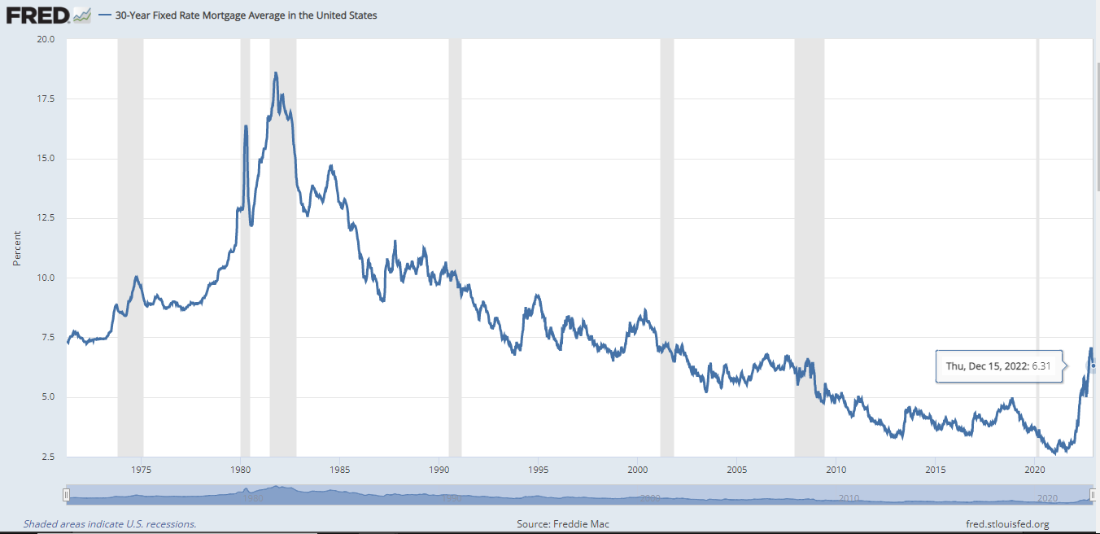
Data of Sourcing https://fred.stlouisfed.org/series/MORTGAGE30US

Slide 6
Inflation Rate
Money inflation will be one of the factor in house price appreciation.
Inflation is caused by excess of money circulation.which essentially causes the value of money to reduce.
When the situation like this happens, the prices for several input items like the cost of land, construction materials, construction labour and statutory building permits, also increase.
Of course, inflation will not result in increased property prices in an area if the location itself is deficient – meaning that it has poor accessibility and social and civic infrastructure, or if it has seen an oversupply of residential projects already.
The inflationary situation in the United States has been relatively severe in 2022 due to global events relating to COVID-19, supply chain restrains, and the Russian invasion of Ukraine.

Slide 7
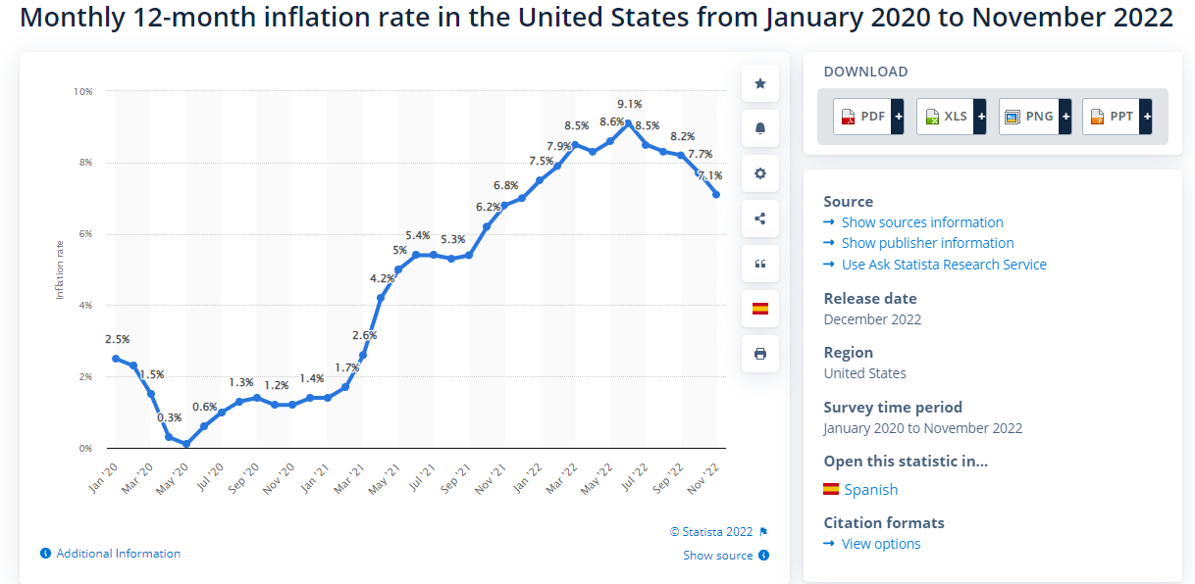
Data of Sourcing https://www.statista.com/statistics/273418/unadjusted-monthly-inflation-rate-in-the-us/

Slide 8
Unemployment
The most important point is economic factors afford to buy the house. Unemployment plays a vital role in economic growth Very few people will have possible to afford a house as unemployment rises. But even fear of unemployment can stop people from entering the real estate market.
Due to Covid pandemic unemployment rate increased.
Unemployment makes one of major impact in the own house affordability.

Slide 9
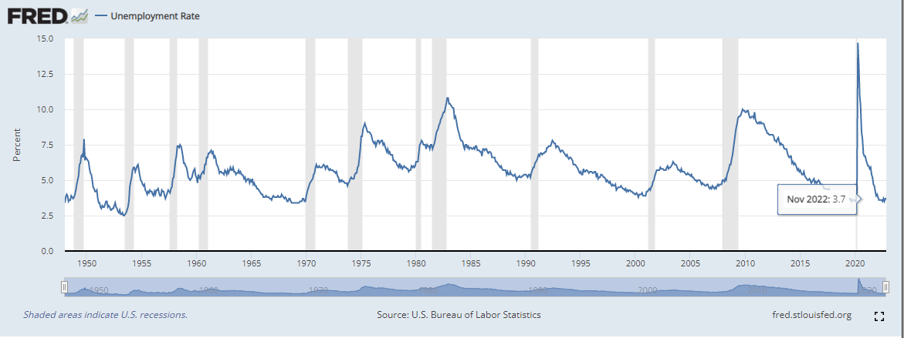
Data of Sourcing https://fred.stlouisfed.org/series/UNRATE

Slide 10
Population Growth
The growth of population in a location obviously results in increasing demand for housing there. Increased demand directly translates into faster appreciation in real estate prices.
Population growth will create the major impact in house price
Always Supply vs Demand have a giant impact of the housing prices.
Also it depends upon the type of population in the country whether they can afford it or not.
Anyhow it will directly affect the rental houses price also in US due to population growth
Factor.

Slide 11
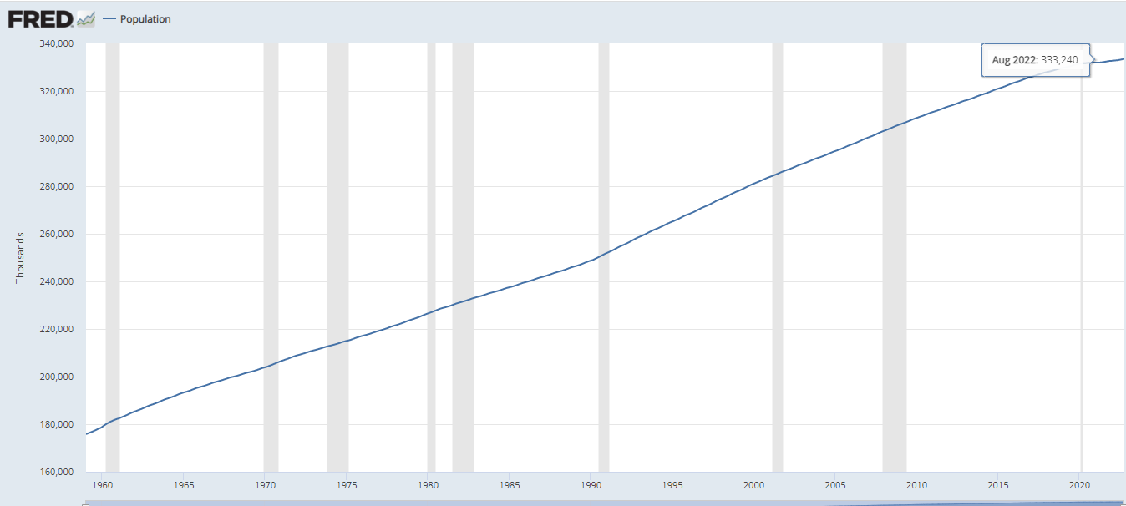
Data of Sourcing https://fred.stlouisfed.org/series/POPTHM

Slide 12
Infrastructure development
Infrastructure development plays a key role in the price appreciation in industry like Any new connectivity, transport, road, or transit hub, will act as a growth driver, as these are expected to bring more population and ultimately, more demand. Investors who time the market right, can get the most out of their real estate investment.
Any new infrastructure amenity development will make great impact the attract the buyers.

Slide 13
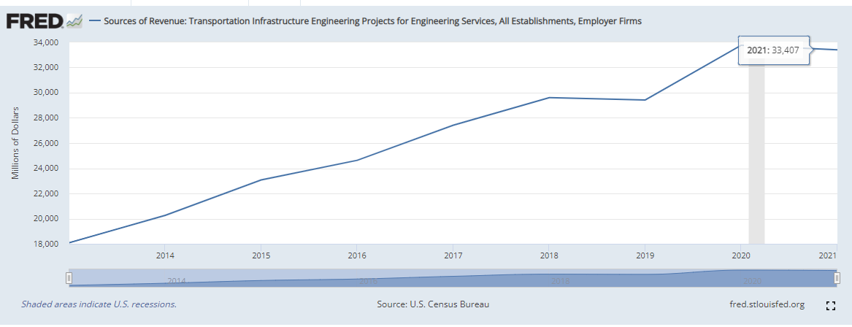
Data of Sourcing https://fred.stlouisfed.org/series/REVTIEEF54133ALLEST

Slide 14
Conclusion
The above factors are considered to be major impact in the next decades of the house price values.

